Slide 1
Curated For You By You
Team : Cache Me If You Can

Slide 2
Agenda
Problem Statement
Project Description
Value Proposition
Targeted Users
Technical Implementation
Project Schedule
Retrospective

Slide 3
Team Members
Emmet Allen - Scrum Master / Systems Architect
Maya Rivera - Front End Dev. Lead
Brian Moran - Full Stack Dev.
Christos Markakis - Data Team - Full Stack Dev.
Ben Smith - Backend Dev - Integrations
Jalen Gill - Front End Team - Integrations
Pete Adams - Back End Lead - Data Team

Slide 4
Problem Statement
It is hard for people to find out what music is local to them given their preferred genre without extensively searching different places such as Tik Tok, Spotify, Google, Youtube, and Reddit to name a few. Even if a person is able to find a local music group, they wouldn’t be necessarily exposed to other music groups that are from the same area and within their preferred genre.
If an up-and-coming bands wants to gain fans that are located within their general region; for example Philadelphia, Pennsylvania; gaining that traction would be hard if they have fans that are from Philadelphia; but currently live in Taiwan.

Slide 5
Project Description
Curated By You, For You
Curated By You, For You is a web application that helps people discover music and artists based on location.
For: musicians, fans, and music industry professionals
Who: want to be discovered, discover others, and stay connected with trends in local music scenes
What It Does Curated By You, For You searches for information about local artists and organizes it by genre and location, so users can make meaningful local discoveries.
Benefit Outcomes By using this app, people will become more knowledgeable about local music scenes, discover new bands they enjoy, and help smaller musicians grow larger fanbases.

Slide 6
Value Proposition
Core Value:
Provide users a way to easily search a location and genre, and introduce artists that hail from that location and perform similar genres.
User Benefit:
Users will be able to consolidate their location based musical taste to one specific application, instead of having to scour the internet for this information.

Slide 7
MVP Feature Prioritization
Feature Name: Location and Genre Based Search
Purpose: Searching Capabilities for Music Artist
User story: As a User, I want to search for artists using a specific location and music genre, so that when I complete the search, I’m provided with a list of artists who are from that location and perform that genre.
Feature Name: Artist Music Listing
Purpose: Provide Artist Music Collection
User story: As a User, when I search an artist using the application, I want to be able to click on an artist, so that I can see their discography

Slide 8
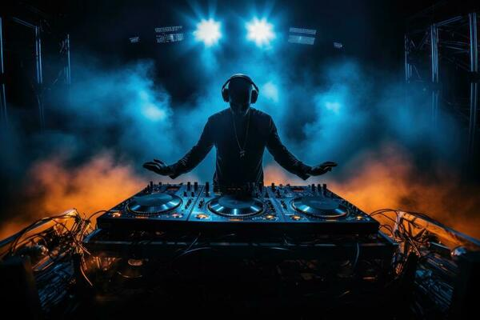
Primary User : DJ Two Tone
Age, 23 Location : New York Occupation: DJ
DJ Two Tone is a local DJ who performs at clubs and parties. While he often mixes popular, well-known tracks into his sets, he’s now looking to incorporate more local cultural music genres to create unique experiences that celebrate the community and connect audiences with the sounds of their own scene.
Issue: Difficulty accessing and integrating unfamiliar cultural music genres—such as Jakarta folk—into performance sets, requiring extensive independent research through scattered sources like record stores, forums, and music databases.
Solution: The platform enables DJs and creators to easily discover and explore local and niche genres by searching specific locations and styles (e.g., Jakarta + Folk Music), instantly connecting them with relevant artists, bands, and tracks to blend seamlessly with their own sets.

Slide 9
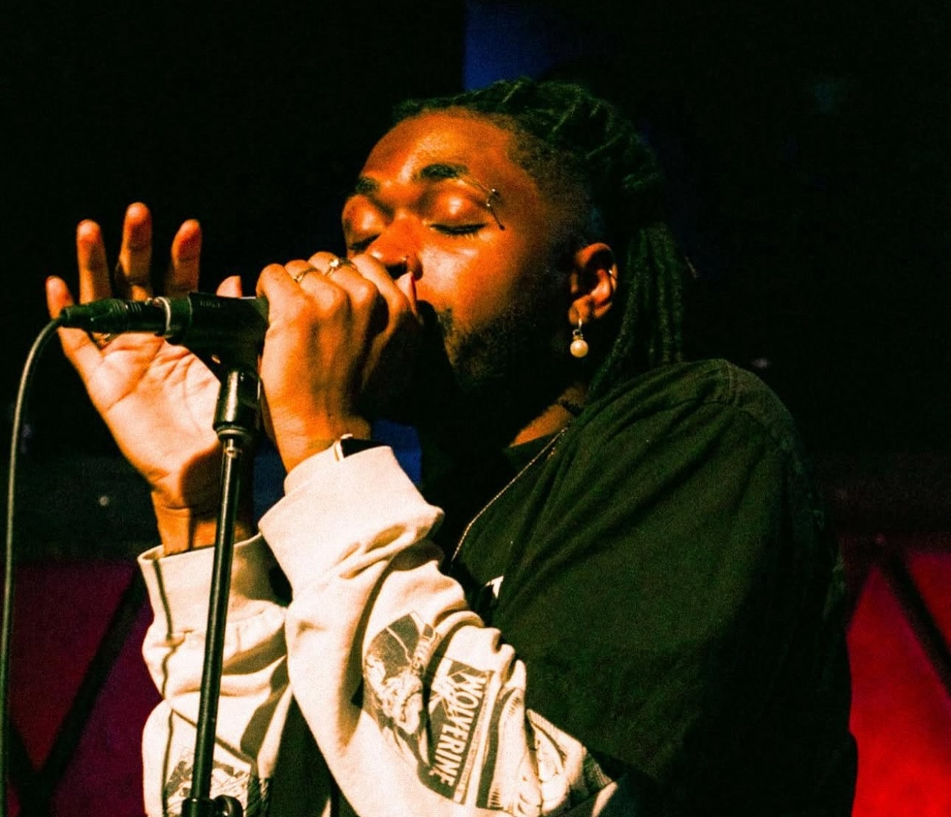
Primary User 2 : Tobi
Age, 29 Location : West Nyack, NY Occupation: Musician
Tobi is a musician looking for his big break into the music industry. He plans on starting in the local scene to build his experience and connections in the industry.
Issue: Music creators face barriers in networking, collaboration, and expanding their creative expertise, limiting growth and visibility.
Solution: Our platform empowers creators by fostering meaningful connections, driving community-driven promotion, and offering tools and resources to continuously expand their skill set.

Slide 10
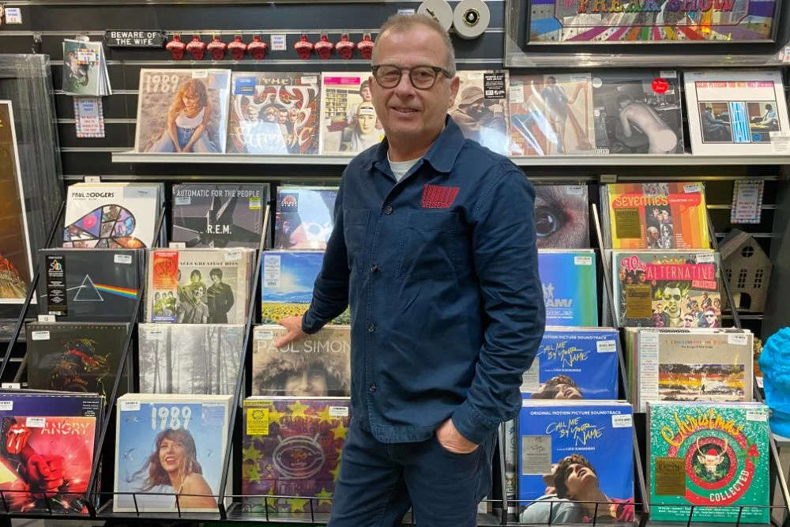
Primary User 3: Glenn
Age, 58 Location : Chattanooga, TN Occupation: Store Manager
Glenn is a store manager that often listens to music in his spare time. He uses apps like Spotify and Apple Music to listen to his preferred music and popular music of today. He wants to immerse himself in new music by discovering new artists locally.
Issue: As a music fan, it can be hard to discover new local performers beyond the big-name acts. Relying on word of mouth or chance encounters often means missing out on fresh talent, especially younger or emerging artists who aren’t promoted widely.
Solution: The platform makes it easy for fans to discover new and local artists tailored to their tastes. By combining personal preferences with location-based recommendations, fans can explore performers they might not otherwise find—helping them connect with fresh music while supporting their local scene.

Slide 11
Algorithms:
CM
Entity Resolution / Deduplication: cleaning and removing dupes from our corpus of data
Hybrid Ranking (RRF): merging tables of similar genres on location proximity and popularity
Inverted Index: classic search engine implementation, used to search for band name, genre, location, and/or description

Slide 12








Technical Implementation
Platform / Technology:
Backend- Python, AWS, Athena, S3
Frontend- React, TypeScript, Tailwind (CSS)
3rd Party APIs : Spotify API, Music Brainz API, EveryNoise.com

Slide 13
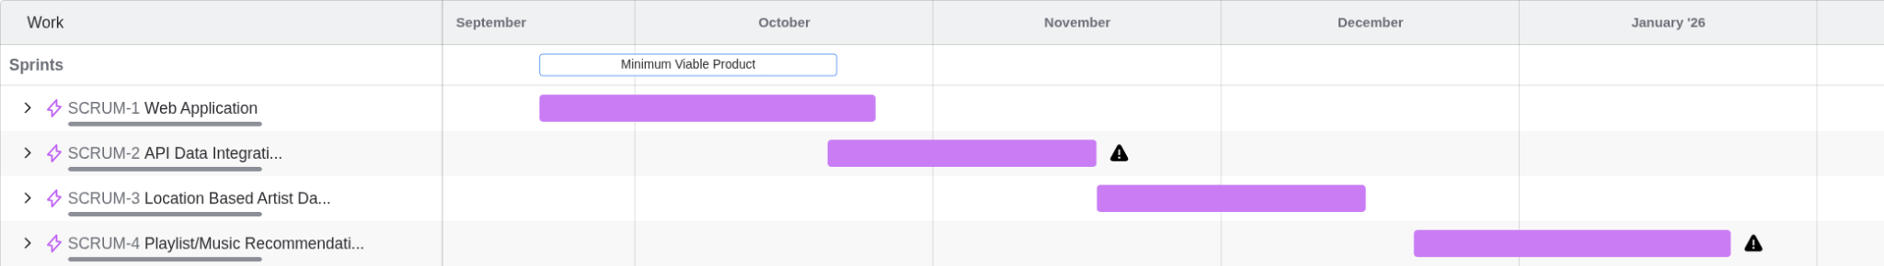
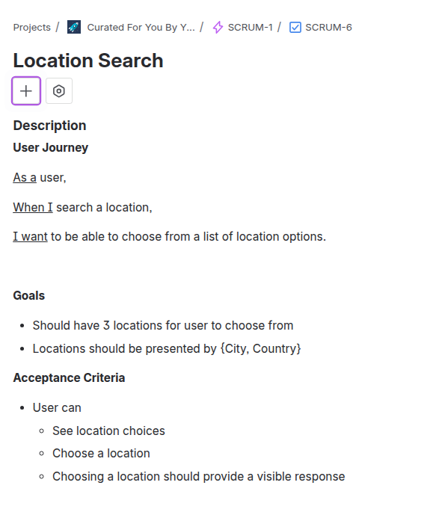
Project Schedule
Sprint 0 : September 2 - September 22
Sprint 1 : September 23 - October 20
Sprint 2 : October 21 - November 17
Sprint 3 : Completion of MVP: November 18 - December 15
Weekly Meetings: Tuesdays at 6:00PM Completion of User Stories and Tasks will be managed through Jira, and each will have defined deadlines and story points.

Slide 14
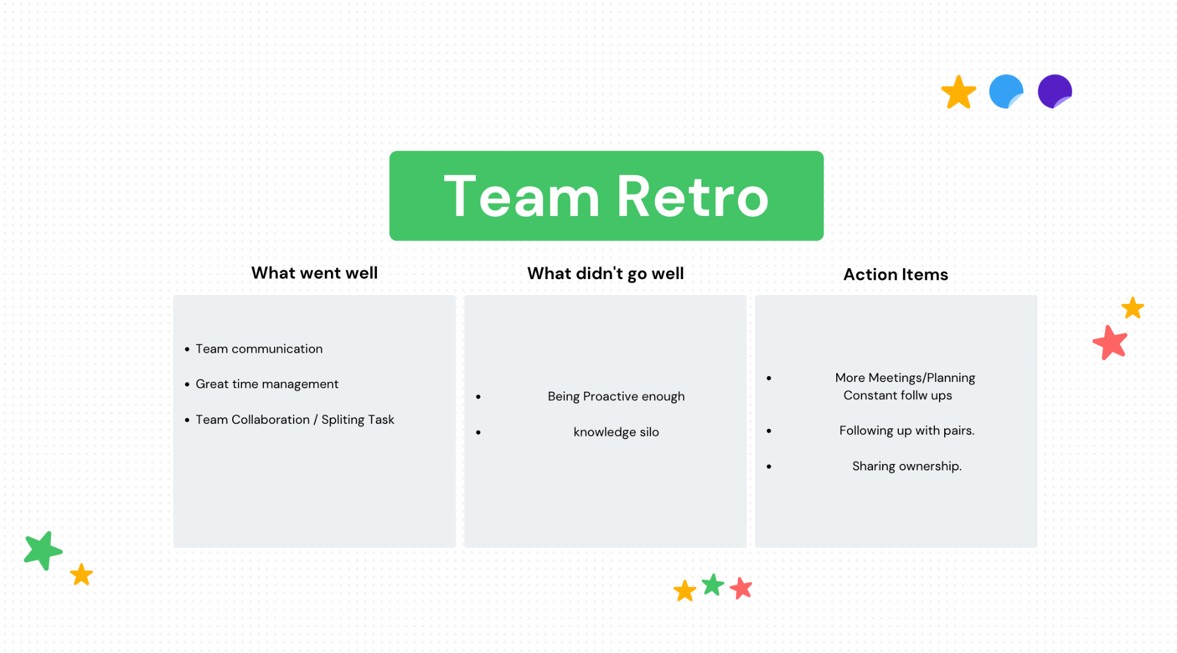
Retrospective

Slide 15
Thank You!
Wiki Page/Github Repo: https://github.com/htmw/F2025-Async/wiki

